Slide 1
Applied Machine Learning
Lecture 3

Slide 2
Outline
Supervised Learning: Notations and Definitions
Linear Regression
LMS Algorithm
Gradient Descent
Learning Rate
Pitfalls of Gradient Descent

Slide 3
Main Challenges of Machine Learning
Insufficient Quantity of Training Data
Nonrepresentative Training Data
Poor-Quality Data
Irrelevant Features
Imbalanced Datasets
Overfitting
Underfitting

Slide 4
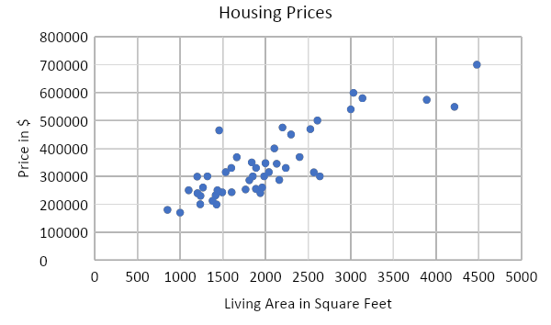
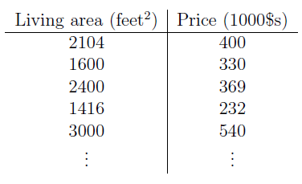
Supervised Learning: Notations and Definitions (1/3)
Suppose we have a dataset giving the living areas and prices of 47 houses from Portland, Oregon.
Given data like this, how can we learn to predict the prices of other houses in Portland, as a function of the size of their living areas?

Slide 5
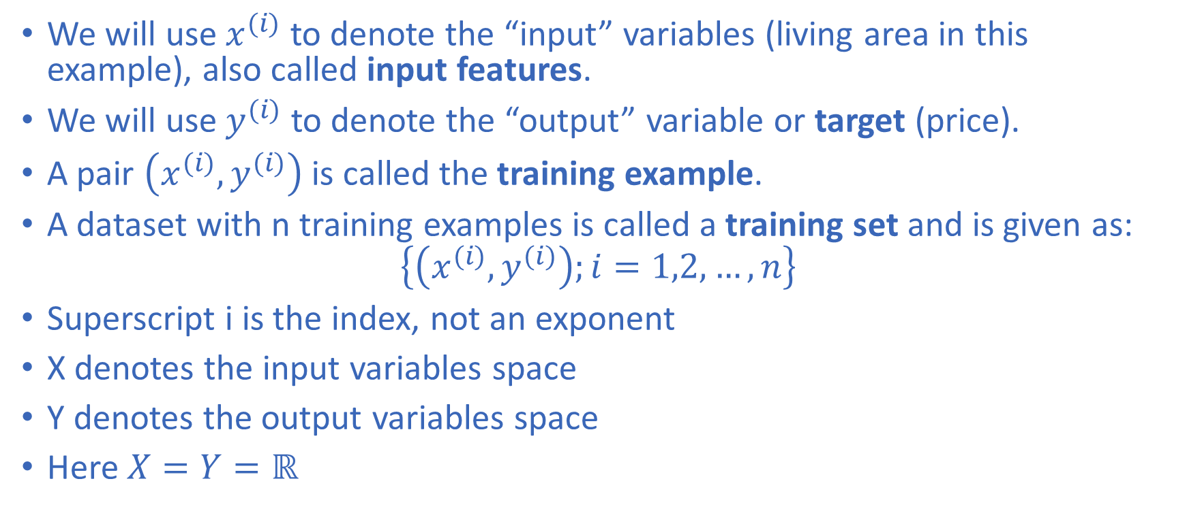
Supervised Learning: Notations and Definitions (2/3)

Slide 6
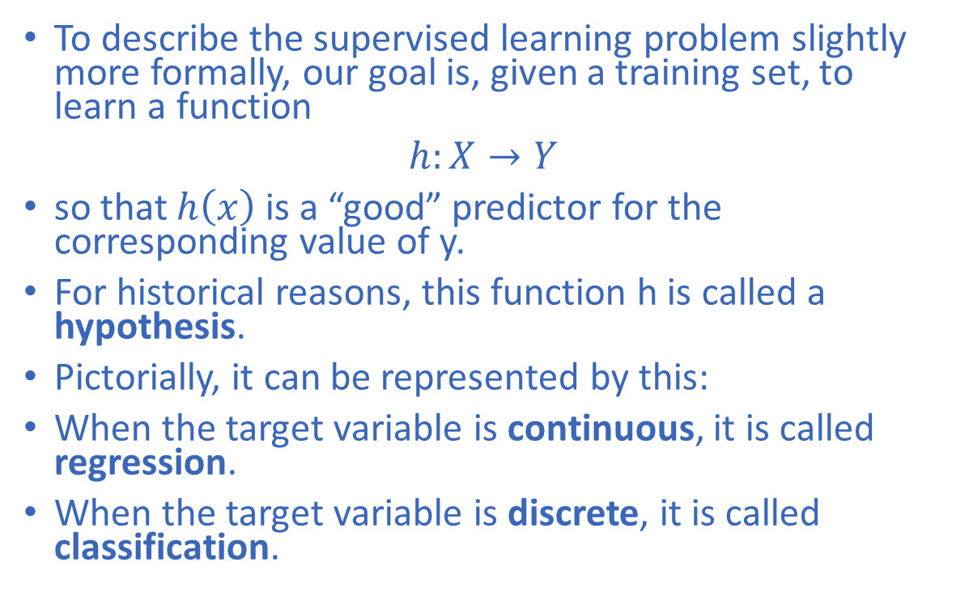
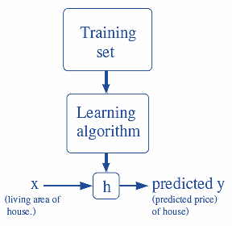
Supervised Learning: Notations and Definitions (3/3)

Slide 7
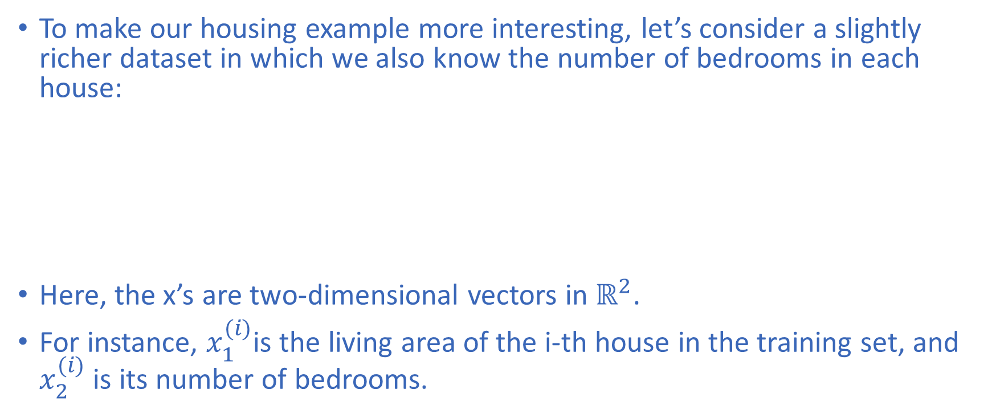
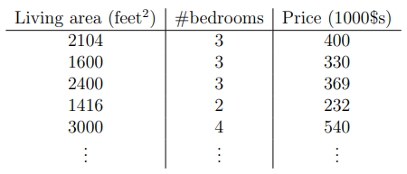
Linear Regression

Slide 8
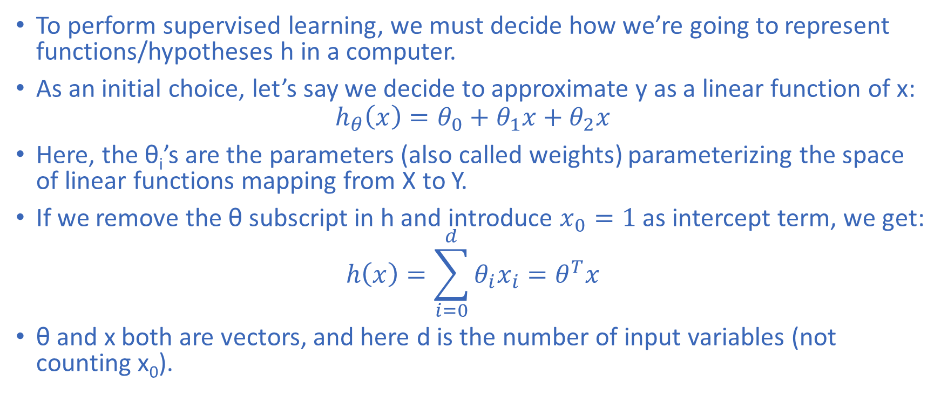
Linear Regression

Slide 9
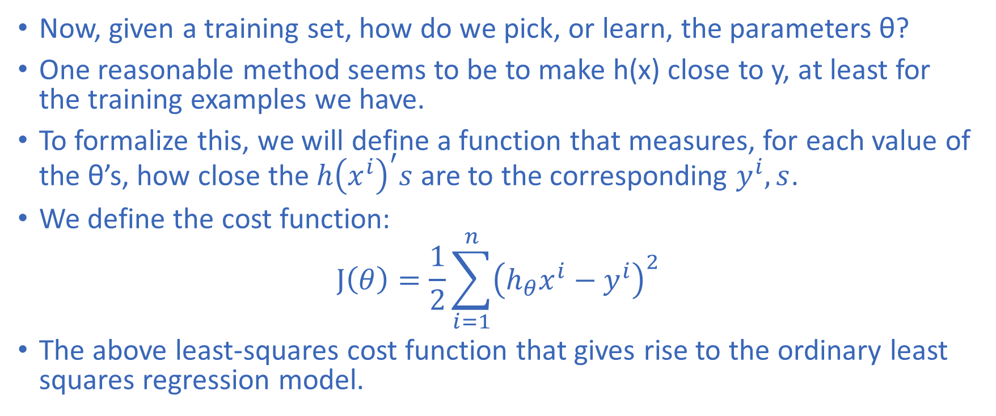
Linear Regression

Slide 10
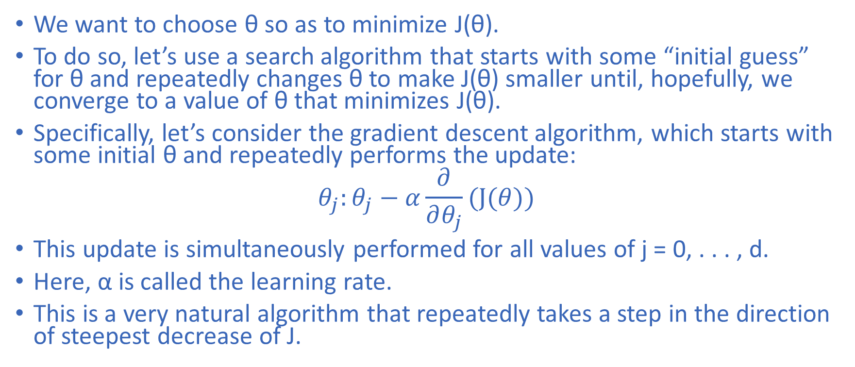
LMS (Least Mean Square) Algorithm

Slide 11
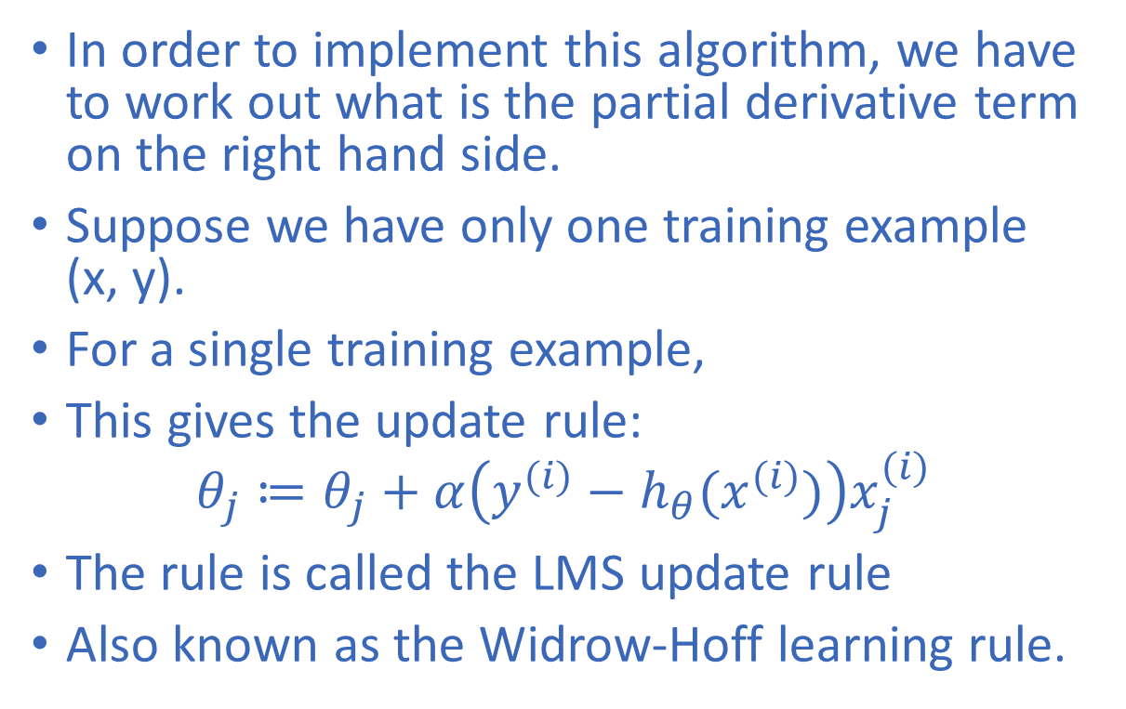
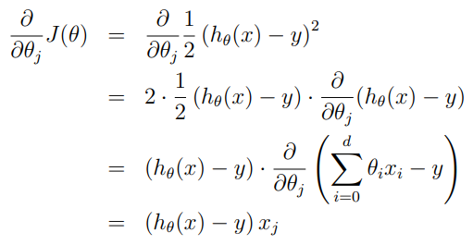
LMS (Least Mean Square) Algorithm

Slide 12
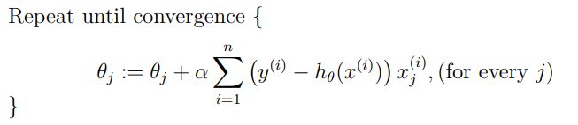

LMS (Least Mean Square) Algorithm
The magnitude of the update is proportional to the error term
If we are encountering a training example on which our prediction nearly matches the actual value of y^{(i)} , then we find that there is little need to change the parameters.
In contrast, a larger change to the parameters will be made if our prediction h_{θ}(x^{(i)}) has a large error (i.e., if it is very far from y^{(i)}).
The derivation is made for one training sample. For entire training set:
By grouping the updates of the coordinates into an update of the vector θ, we can rewrite the above update in a slightly more succinct way:

Slide 13
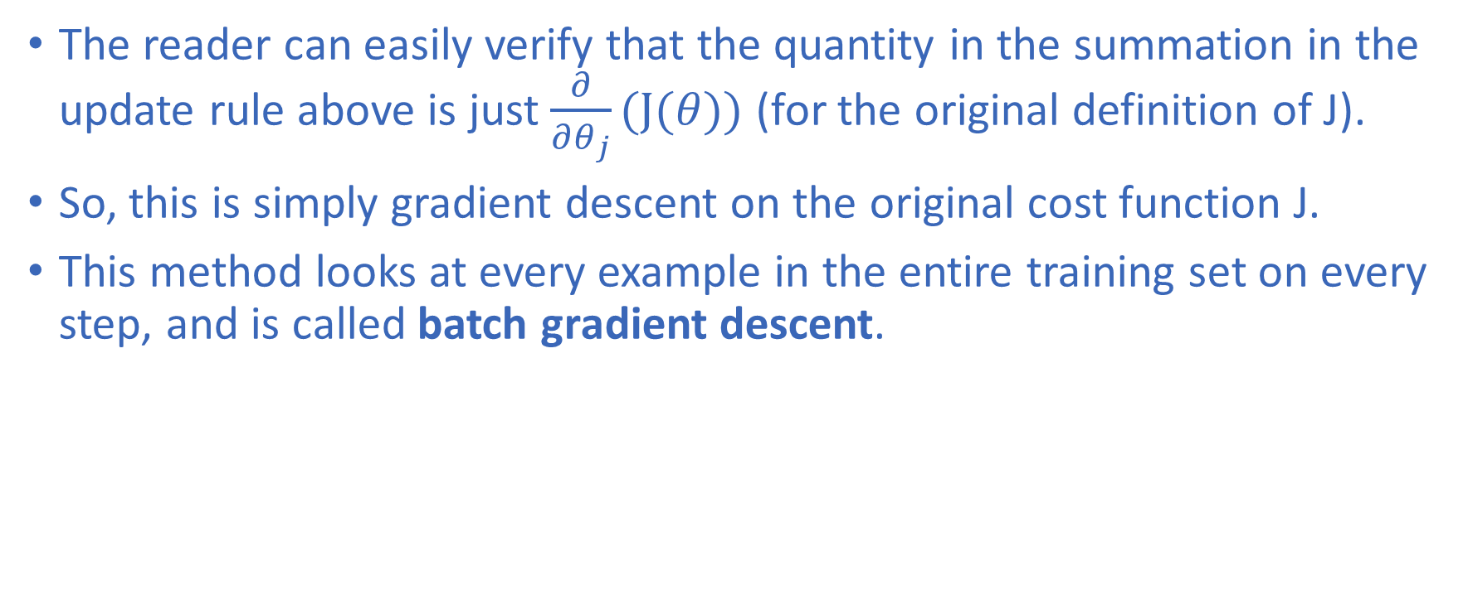
Gradient Descent

Slide 14
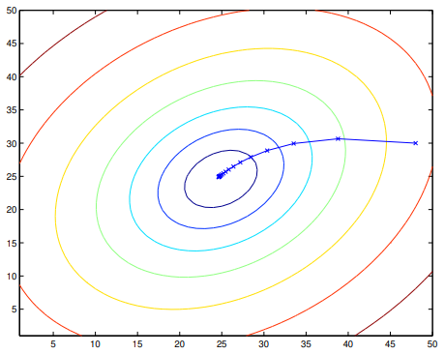
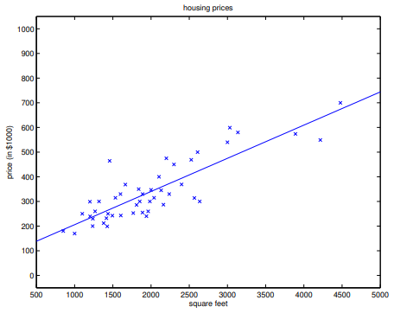
Gradient Descent
The ellipses shown here are the contours of a quadratic function.
Also shown is the trajectory taken by gradient descent, which was initialized at (48,30).
The x’s in the figure (joined by straight lines) mark the successive values of θ that gradient descent went through.
When we run batch gradient descent to fit θ on our previous dataset, to learn to predict housing price as a function of living area, we obtain:
θ₀ = 71.27, θ₁ = 0.1345.
If we plot h_{θ}(x) as a function of x (area), along with the training data, we obtain the following figure:

Slide 15
Problems with Gradient Descent
Local Minima and Saddle Points
  The algorithm can get trapped in a small valley (local minimum) or a flat area (saddle point) where the slope is zero, failing to find the true lowest point (global minimum).
Improper Learning Rate
  If the step size is too large, the algorithm can overshoot the minimum and diverge; if it is too small, training becomes extremely slow.
Horizontal Oscillation
  Vanilla gradient descent can zigzag back and forth instead of moving straight toward the minimum, especially in high-dimensional spaces.
Vanishing and Exploding Gradients
  In deep neural networks, gradients can shrink close to zero (stopping learning in early layers) or grow excessively large (causing unstable updates).

Slide 16
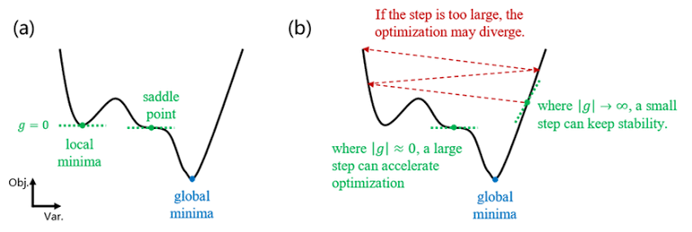
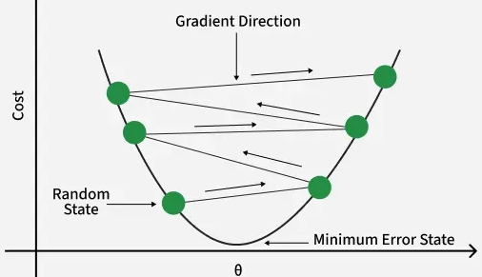
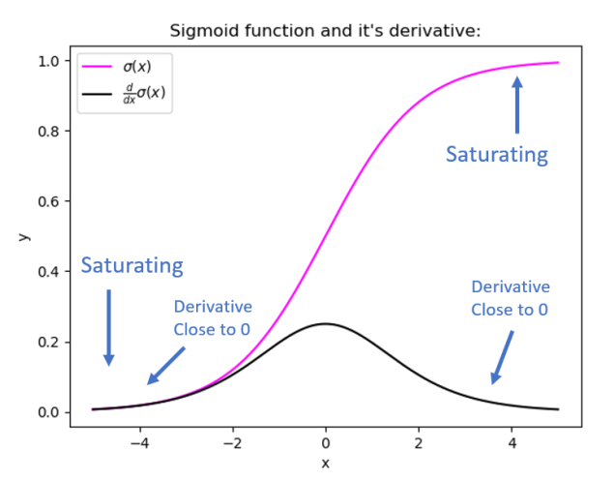
Problems with Gradient Descent

Slide 17
Applied Machine Learning
Lecture 4

Slide 18
Outline
Gradient Descent
Pitfalls of Gradient Descent
Stochastic Gradient Descent
Mini-Batch Gradient Descent
The Normal Equation
Probabilistic interpretation
Locally weighted linear regression

Slide 19
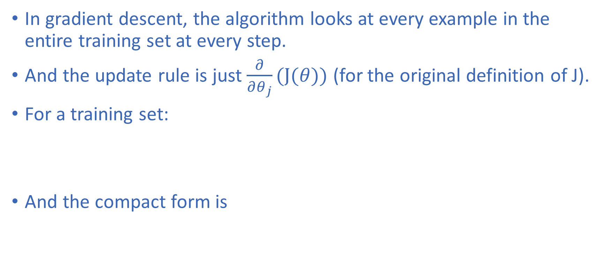
Gradient Descent

Slide 20
Problems with Gradient Descent

Slide 21
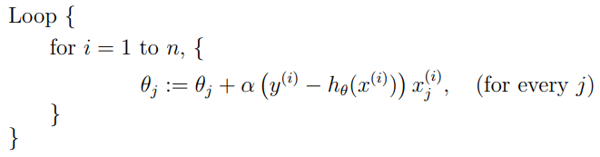
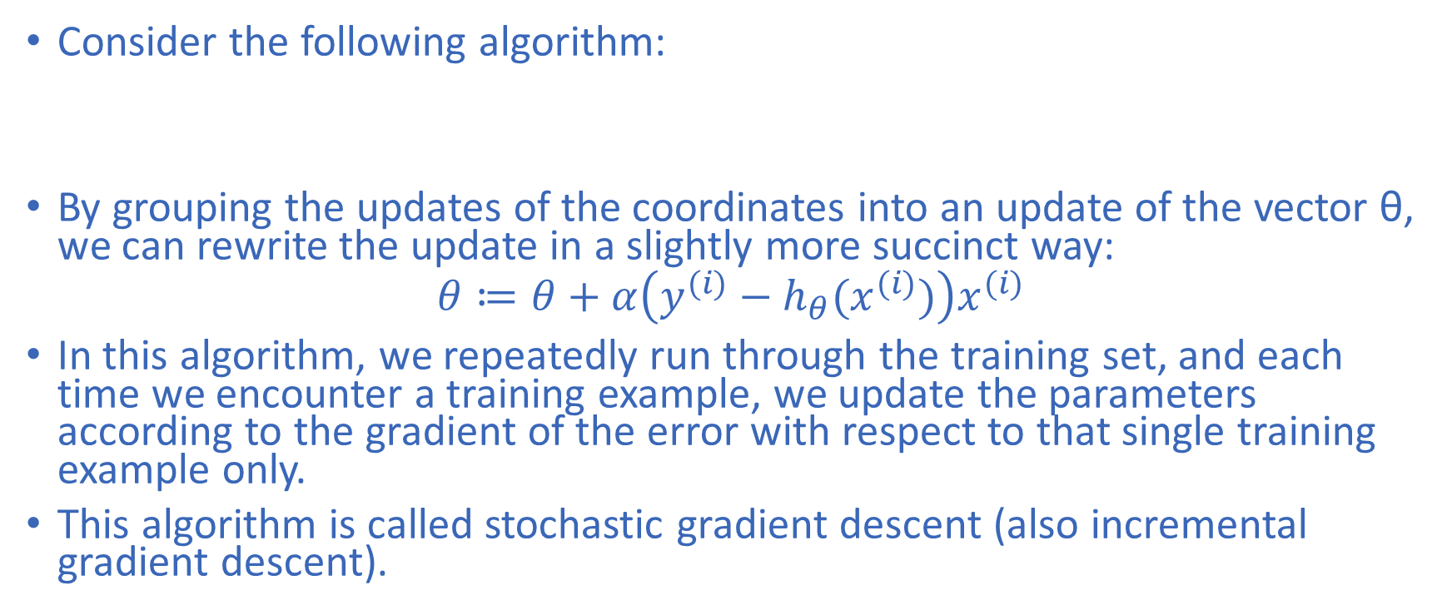
Stochastic Gradient Descent (1/2)

Slide 22
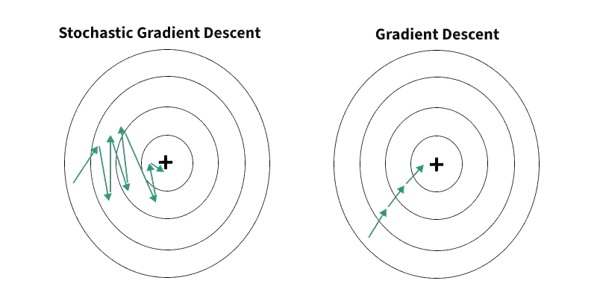
Stochastic Gradient Descent (2/2)
Unlike batch gradient descent, stochastic gradient descent can start making progress right away and continues to make progress with each example it looks at.
Often, stochastic gradient descent gets θ “close” to the minimum much faster than batch gradient descent.
Particularly when the training set is large, stochastic gradient descent is often preferred over batch gradient descent.

Slide 23
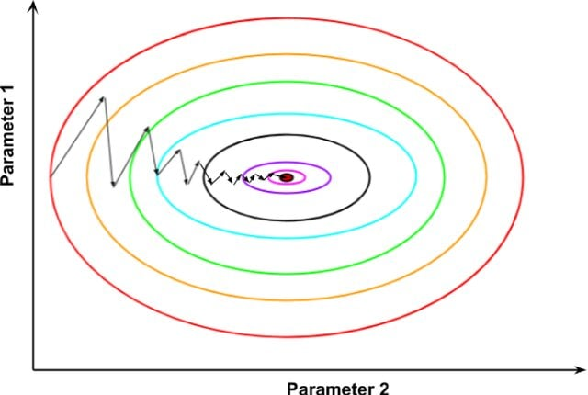
Mini-batch Gradient Descent
At each step, instead of computing the gradients based on the full training set (as in Batch GD) or based on just one instance (as in Stochastic GD), Mini-batch GD computes the gradients on small random sets of instances called minibatches.
The main advantage of Mini-batch GD over Stochastic GD is that you can get a performance boost from hardware optimization of matrix operations, especially when using GPUs.
The algorithm’s progress in parameter space is less erratic than with SGD, especially with fairly large mini-batches.
As a result, Mini-batch GD will end up walking around a bit closer to the minimum than SGD.
But, on the other hand, it may be harder for it to escape from local minima

Slide 24
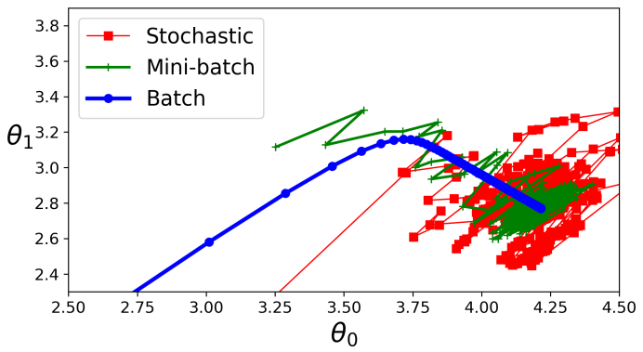
Comparison of BGD, SGD, and MBGD
For a linear regression problem, all end up near the minimum
Batch GD’s path actually stops at the minimum
While both Stochastic GD and Mini-batch GD continue to walk around.
However, don’t forget that Batch GD takes a lot of time to take each step
Stochastic GD and Mini-batch GD would also reach the minimum if you used a good learning schedule.

Slide 25
Alternate Way of Minimizing J
Gradient descent gives one way of minimizing J.
Let’s discuss a second way of doing so, this time performing the minimization explicitly and without resorting to an iterative algorithm.
In this method, we will minimize J by explicitly taking its derivatives with respect to the θ_{j}’s, and setting them to zero.
To enable us to do this without having to write reams of algebra and pages full of matrices of derivatives.

Slide 26
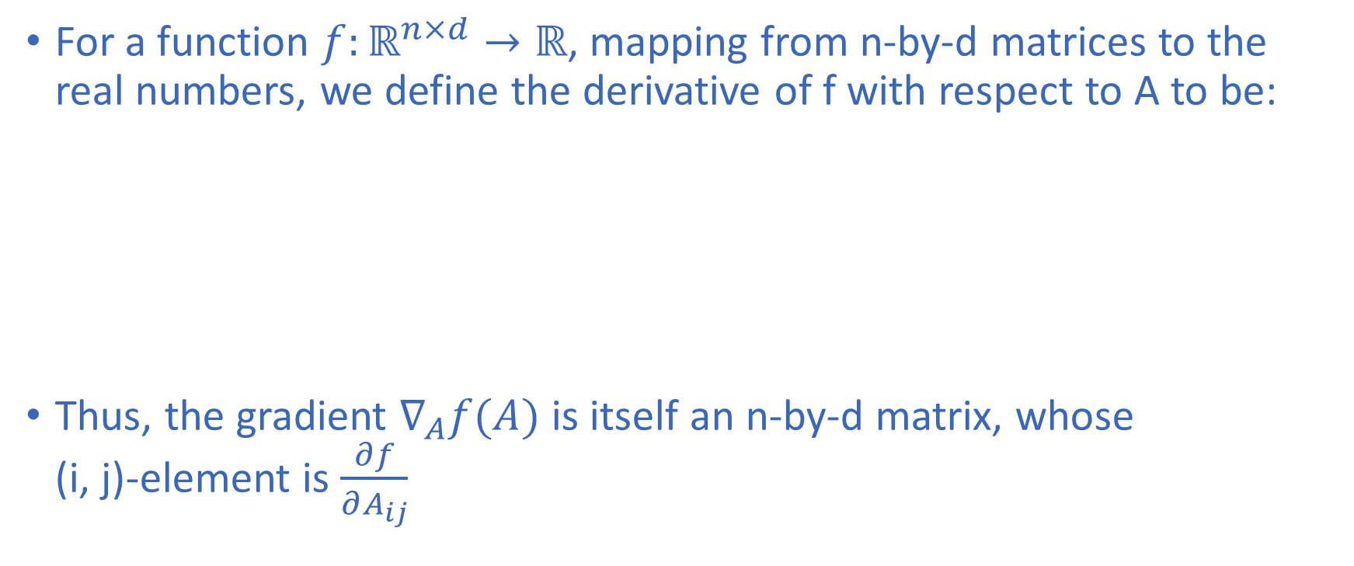
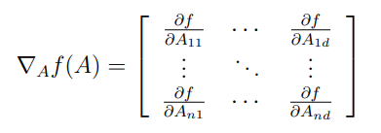
Matrix Derivatives (1/2)

Slide 27
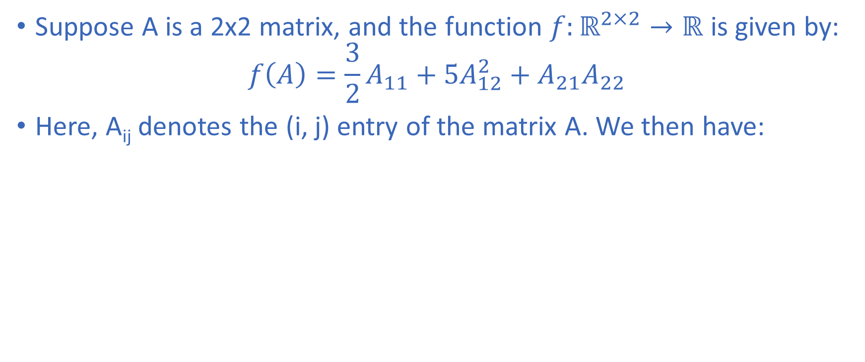

Matrix Derivatives (2/2)

Slide 28
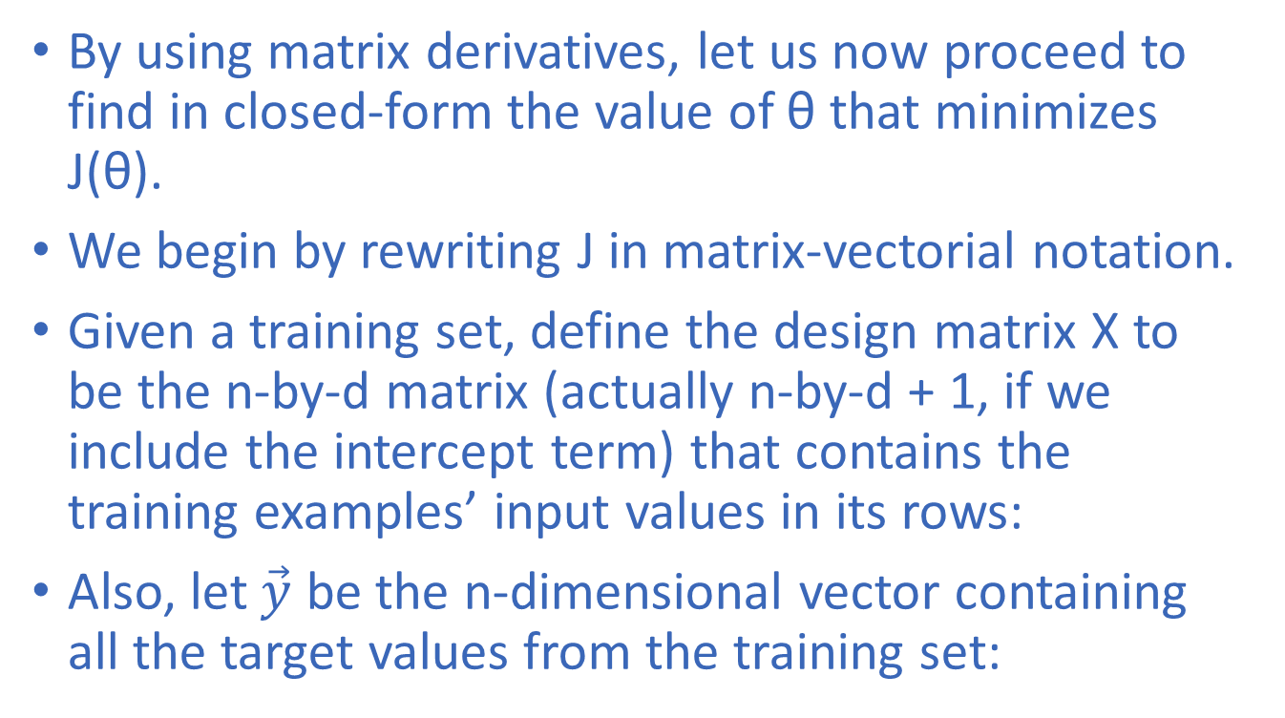
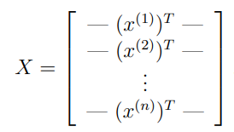
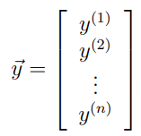
Least Squares with Matrices (1/3)

Slide 29
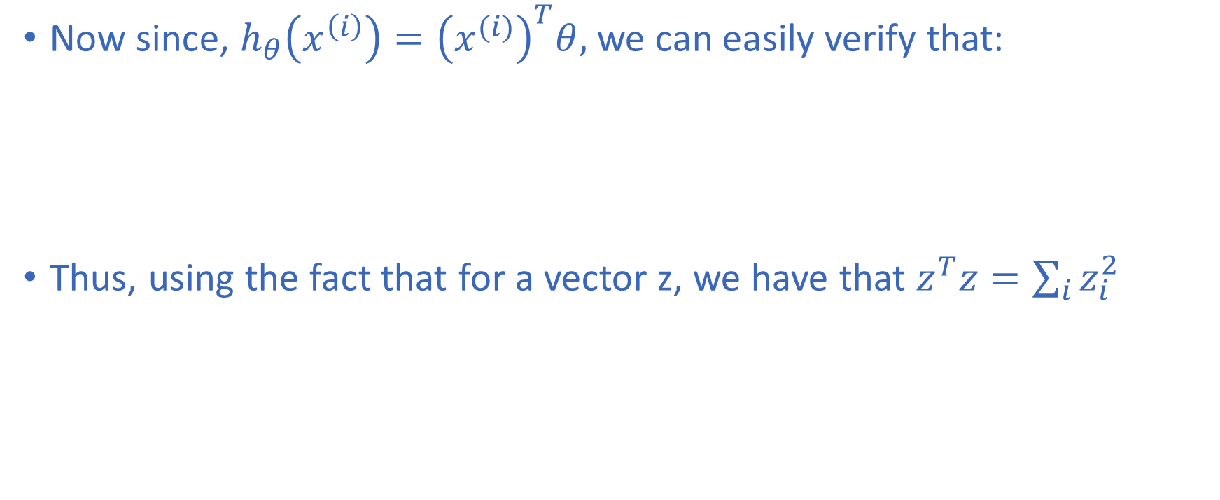
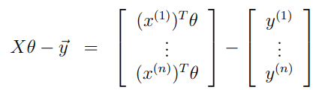
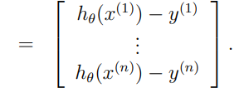


Least Squares with Matrices (2/3)

Slide 30
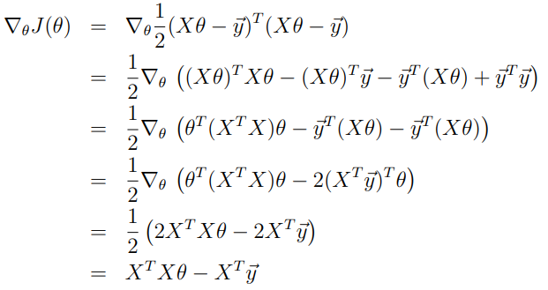


Least Squares with Matrices
Finally, to minimize J, let’s find its derivatives with respect to θ. Hence,

Slide 31
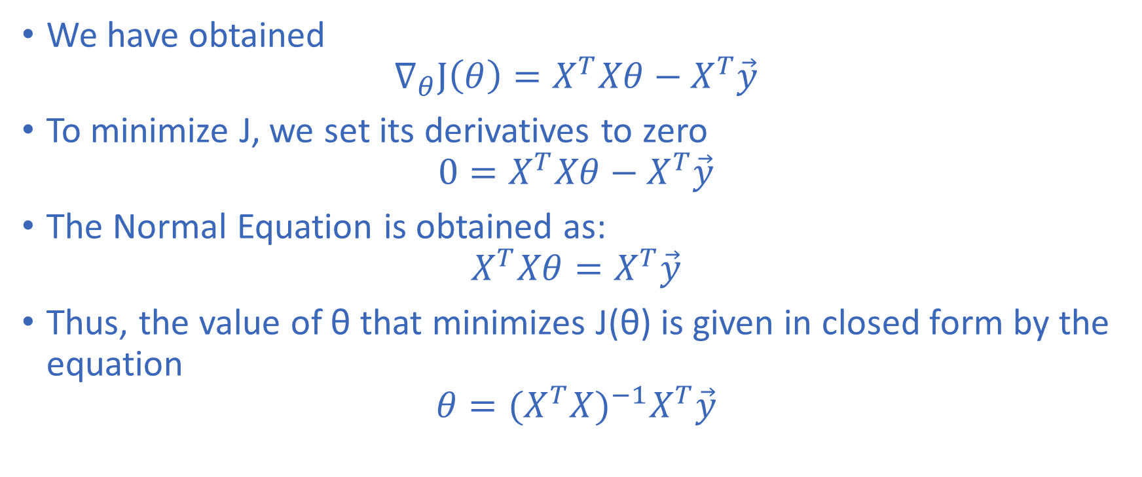
The Normal Equation

Slide 32
Probabilistic Interpretation (1/3)
When faced with a regression problem, why might linear regression, and specifically why might the least-squares cost function J, be a reasonable choice?
Why might we use a linear model?
  We could start with a simple assumption:
  As the covered area and number of bedrooms increase, the price increases.
How do we decide which line is "best"?
  Calculate the prediction error for every example, square each error, and add them together.
  The model tries to find the parameters that make this number as small as possible.

Slide 33
Probabilistic Interpretation (2/3)
Why not simply add the errors?
  Because positive and negative errors can cancel each other.
Why does a large error matter more?
  The large error gets a much larger penalty.
  This is often desirable because we don't want a model to make some extremely bad predictions.

Slide 34
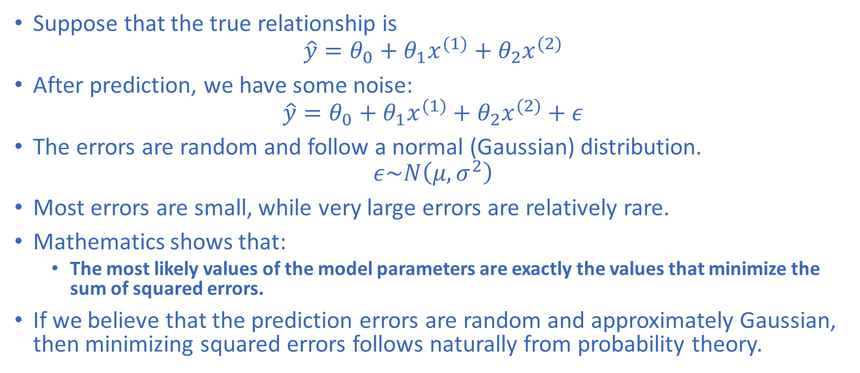
Probabilistic Interpretation (3/3)

Slide 35
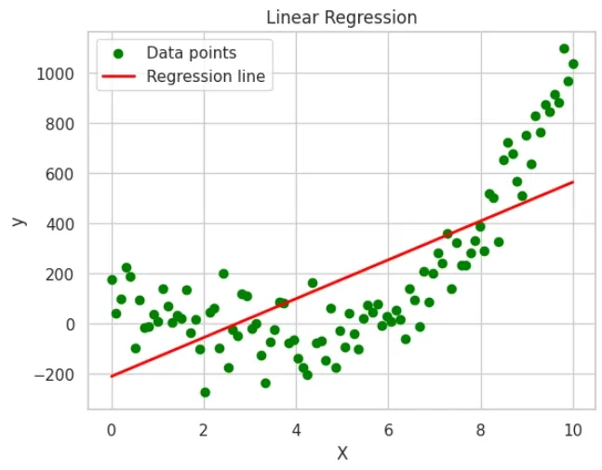
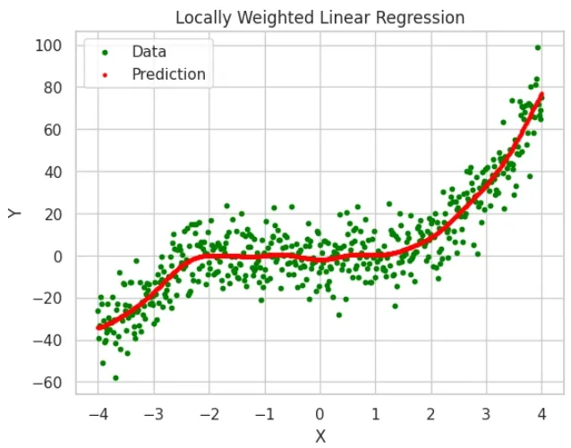
Locally Weighted Linear Regression (1/2)
Locally Weighted Linear Regression is a modified version of ordinary linear regression.
When predicting the output for a particular point, give more importance to training examples that are close to that point and less importance to examples that are far away.

Slide 36
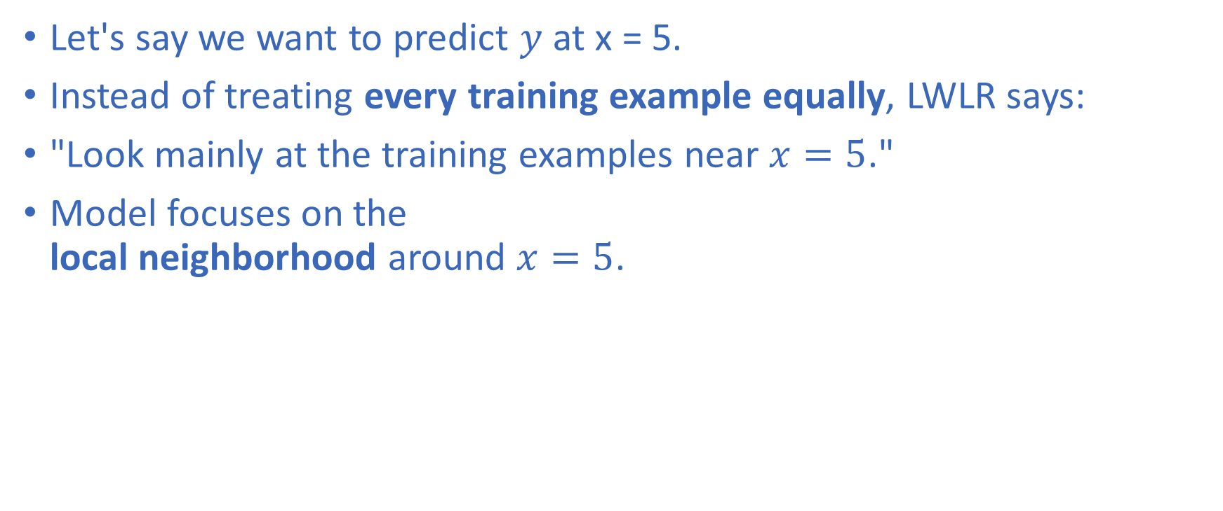

Locally Weighted Linear Regression (2/2)
Training point |  | Importance
 | Very small | Very high
 | Very small | Very high
 | Moderate | Medium
 | Large | Low
 | Very large | Almost none
Tau (τ) is called bandwidth or smoothing parameter. It controls how local the model is.

